Slide 1
Chapters 13-14:
File-System Interface & Implementation

Slide 2
File Operations
File is an abstract data type
Create
Write – at write pointer location
Read – at read pointer location
Reposition within file - seek
Delete
Truncate
Open(F_{i}) – search the directory structure on disk for entry F_{i}, and move the content of entry to memory
Close (F_{i}) – move the content of entry F_{i} in memory to directory structure on disk

Slide 3

File Types – Name, Extension

Slide 4
Access Methods
Sequential Access
read next
write next
reset
Direct Access – file is fixed length logical records
read n
write n
position to n
read next
write next
n = relative block number

Slide 5

Tree-Structured Directories

Slide 6

Tree-Structured Directories
Absolute or relative path name
Creating a new file is done in current directory
Delete a file
rm <file-name>
Creating a new subdirectory is done in current directory
  mkdir <dir-name>
  Example: if in current directory /mail
  mkdir count
Deleting “mail” -r ⇒ deleting the entire subtree rooted by “mail”

Slide 7

General Graph Directory

Slide 8
File Sharing
Sharing of files on multi-user systems is desirable
Sharing may be done through a protection scheme
On distributed systems, files may be shared across a network
If multi-user system
  User IDs identify users, allowing permissions and protections to be per-user
  Group IDs allow users to be in groups, permitting group access rights
  Owner of a file / directory
  Group of a file / directory

Slide 9
Protection
File owner/creator should be able to control:
  what can be done
  by whom
Types of access
  Read
  Write
  Execute
  Append
  Delete
  List

Slide 10

Access Lists and Groups
Mode of access: read, write, execute
Three classes of users on Unix / Linux
RWX
a) owner access 7 ⇒ 1 1 1
RWX
b) group access 6 ⇒ 1 1 0
RWX
c) public access 1 ⇒ 0 0 1
Ask manager to create a group (unique name), say G, and add some users to the group.
For a particular file (say game) or subdirectory, define an appropriate access.
Attach a group to a file
chgrp G game

Slide 11

A Sample UNIX Directory Listing

Slide 12
File-System Structure
File system resides on secondary storage (disks)
  Provided user interface to storage, mapping logical to physical
  Provides efficient and convenient access to disk by allowing data to be stored, located retrieved easily
Disk provides in-place rewrite and random access
  I/O transfers performed in blocks of sectors (usually 512 bytes)
File control block (FCB) – storage structure consisting of information about a file
  inode in UNIX file systems
Device driver controls the physical device

Slide 13
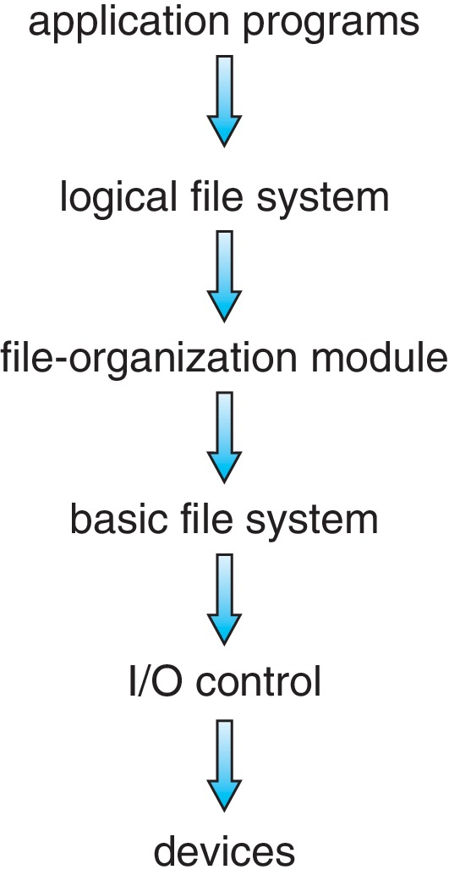
Layered File System

Slide 14
File System Layers
Device drivers manage I/O devices at the I/O control layer
  Given commands like “read drive1, cylinder 72, track 2, sector 10, into memory location 1060” outputs low-level hardware specific commands to hardware controller
Basic file system given command like “retrieve block 123” translates to device driver
  Also manages memory buffers and caches (allocation, freeing, replacement)
    Buffers hold data in transit
    Caches hold frequently used data
File organization module understands files, logical address, and physical blocks
    Translates logical block # to physical block #
    Manages free space, disk allocation

Slide 15
File System Layers (Cont.)
Logical file system manages metadata information
  Translates file name into file number, file handle, location by maintaining file control blocks (inodes in UNIX)
  Directory management
  Protection
Layering useful for reducing complexity and redundancy, but adds overhead and can decrease performance
Translates file name into file number, file handle, location by maintaining file control blocks (inodes in UNIX)
  Logical layers can be implemented by any coding method according to OS designer

Slide 16
File System Layers (Cont.)
Many file systems, sometimes many within an operating system
  Each with its own format
    CD-ROM is ISO 9660
    Unix has UFS, FFS
    Windows has FAT, FAT32, NTFS as well as floppy, CD
    Linux has more than 130 types, with extended file system ext3 and ext4 leading; plus distributed file systems, etc.)
  New ones still arriving
    ZFS, GoogleFS, Oracle ASM, FUSE

Slide 17
File-System Operations
Boot control block contains info needed by system to boot OS from that volume
  Needed if volume contains OS, usually first block of volume
Volume control block (superblock, master file table) contains volume details
  Total # of blocks, # of free blocks, block size, free block pointers or array
Directory structure organizes the files
  Names and inode numbers, master file table

Slide 18
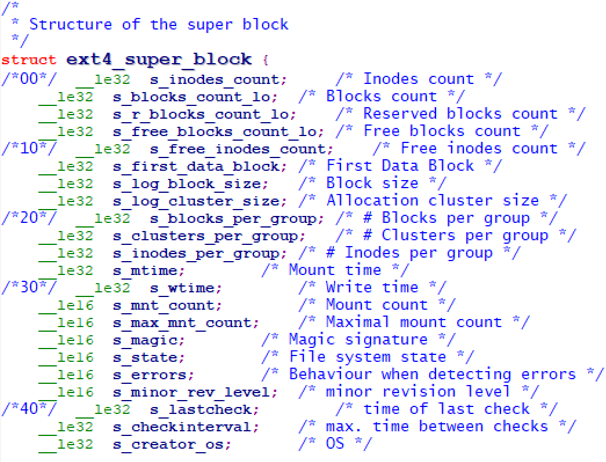
Ext4_super_block (fs/ext4.h, Linux v5.3)

Slide 19
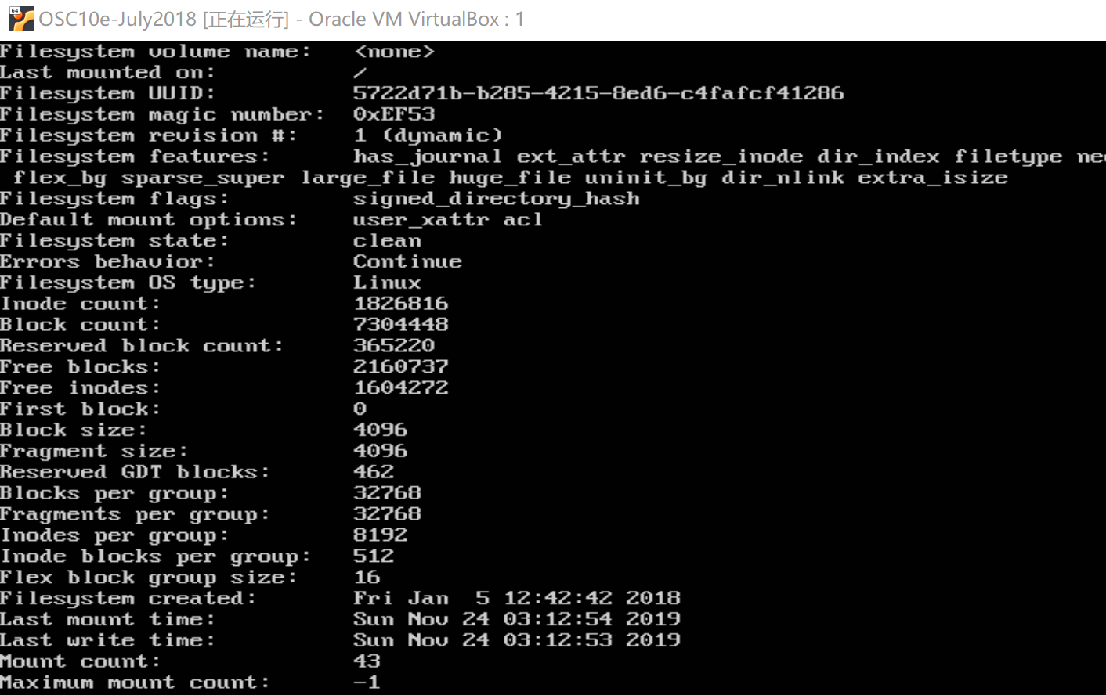
Linux ext4 superblock

Slide 20

File-System Implementation (Cont.)
Per-file File Control Block (FCB) contains many details about the file
  typically inode number, permissions, size, dates

Slide 21
Directory Implementation
Linear list of file names with pointer to the data blocks
  Simple to program
  Time-consuming to execute
    Linear search time
    Could keep ordered alphabetically via linked list or use B+ tree
Hash Table – linear list with hash data structure
  Decreases directory search time
  Collisions – situations where two file names hash to the same location

Slide 22
Allocation Methods - Contiguous
An allocation method refers to how disk blocks are allocated for files:
Contiguous allocation – each file occupies set of contiguous blocks
  Best performance in most cases
  Simple – only starting location (block #) and length (number of blocks) are required
  Problems include finding space for file, knowing file size, external fragmentation
  Needs compaction off-line (downtime) or on-line for HDD

Slide 23
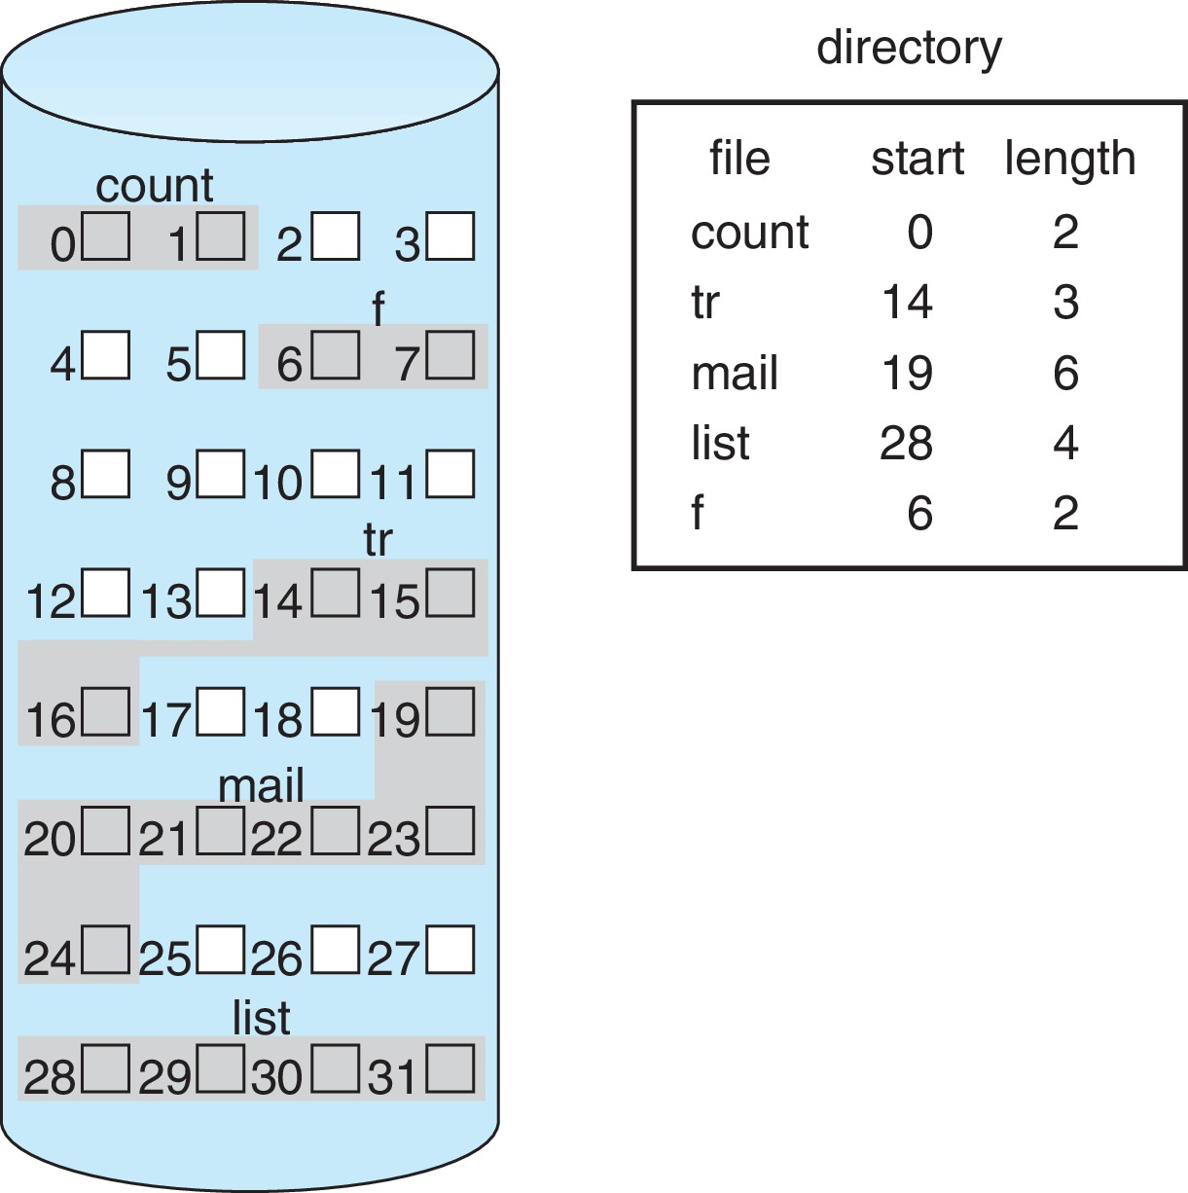
Contiguous Allocation
Mapping from logical to physical
Q
LA/512
R
  Block to be accessed = Q + starting address
  Displacement into block = R

Slide 24
Allocation Methods - Linked
Linked allocation – each file a linked list of blocks
  Each block contains pointer to next block, file ends at nil pointer
  No external fragmentation, no compaction
  Free space management system called when new block needed
  Improve efficiency by clustering blocks into groups but increases internal fragmentation
  Reliability can be a problem
  Locating a block can take many I/Os and disk seeks

Slide 25
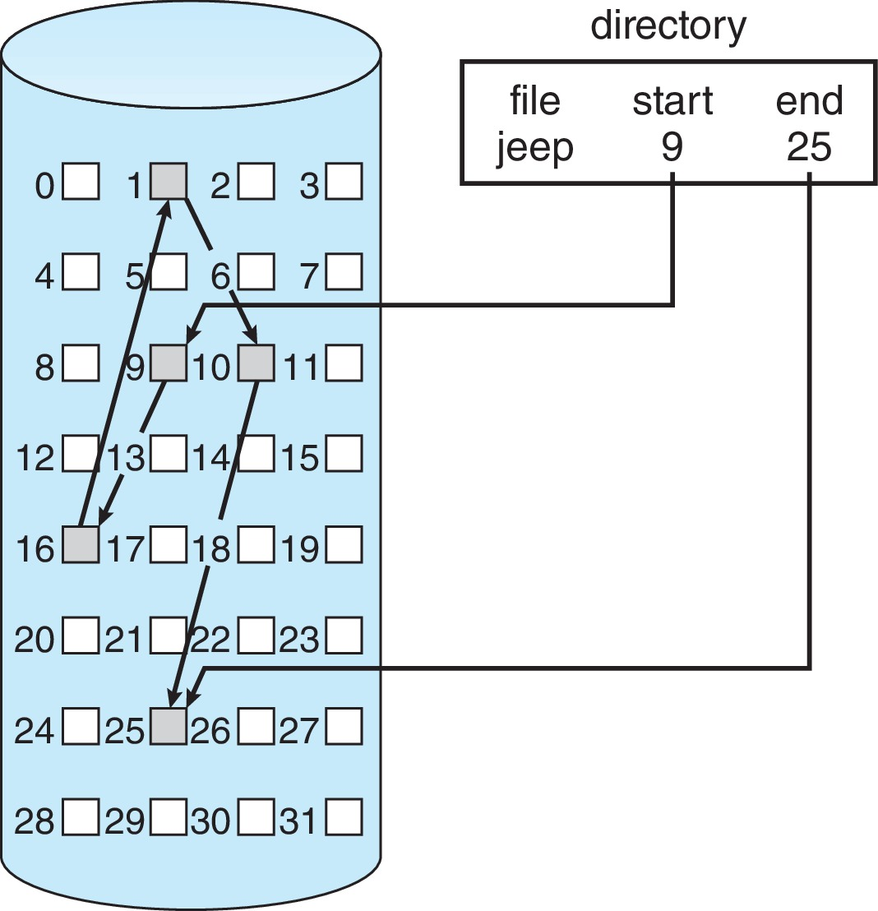
Linked Allocation

Slide 26
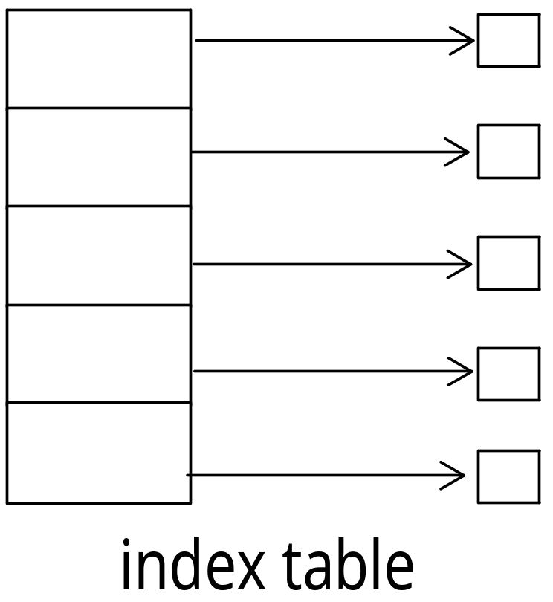
Allocation Methods - Indexed
Indexed allocation
  Each file has its own index block(s) of pointers to its data blocks
Logical view

Slide 27
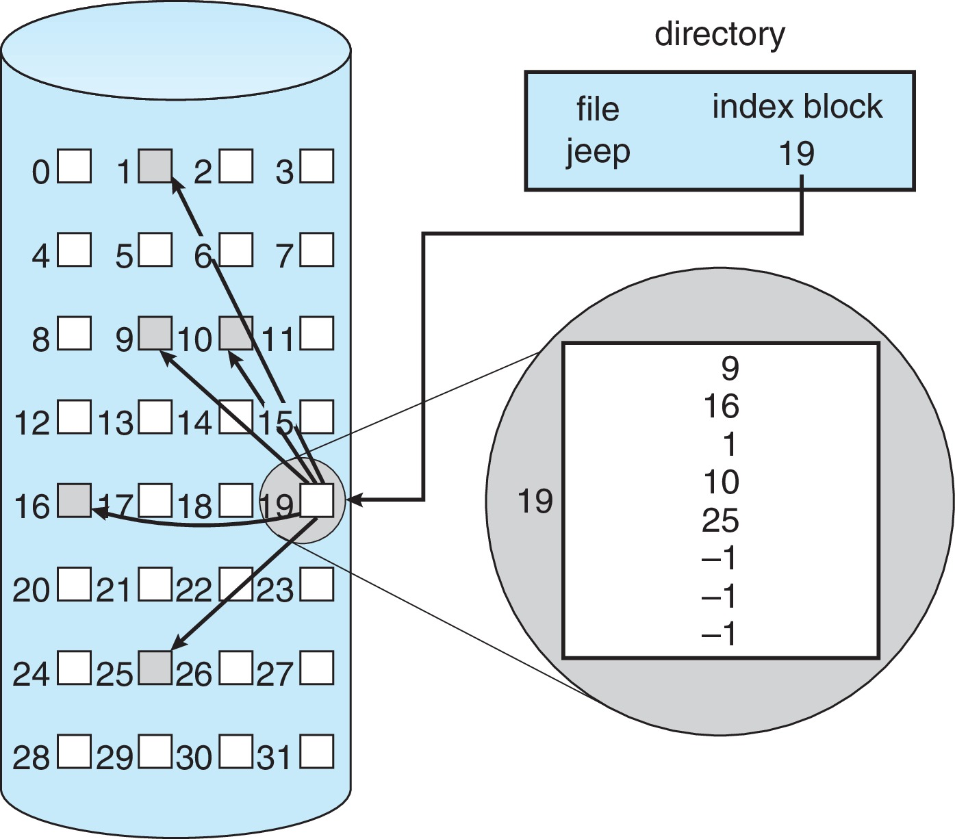
Example of Indexed Allocation

Slide 28
Indexed Allocation (Cont.)
Need index table, which facilitates random access
Dynamic access without external fragmentation, but have overhead of index block
Mapping from logical to physical in a file of maximum size of 256K bytes and block size of 512 bytes. We need only 1 block for index table
Q
LA/512
R
Q = displacement into index table
R = displacement into block

Slide 29
Indexed Allocation – Mapping (Cont.)
Linked scheme
  Link blocks of index table (no limit on size)
  Mapping from logical to physical in a file of unbounded length
Multilevel Index
  Uses a first-level index block to point to a set of second-level index blocks, which in turn point to the file blocks.
  With 4,096-byte blocks, we could store 1,024 four-byte pointers in an index block. Two levels of indexes allow 1,048,576 data blocks and a file size of up to 4 GB
  Could be continued to a third or fourth level

Slide 30
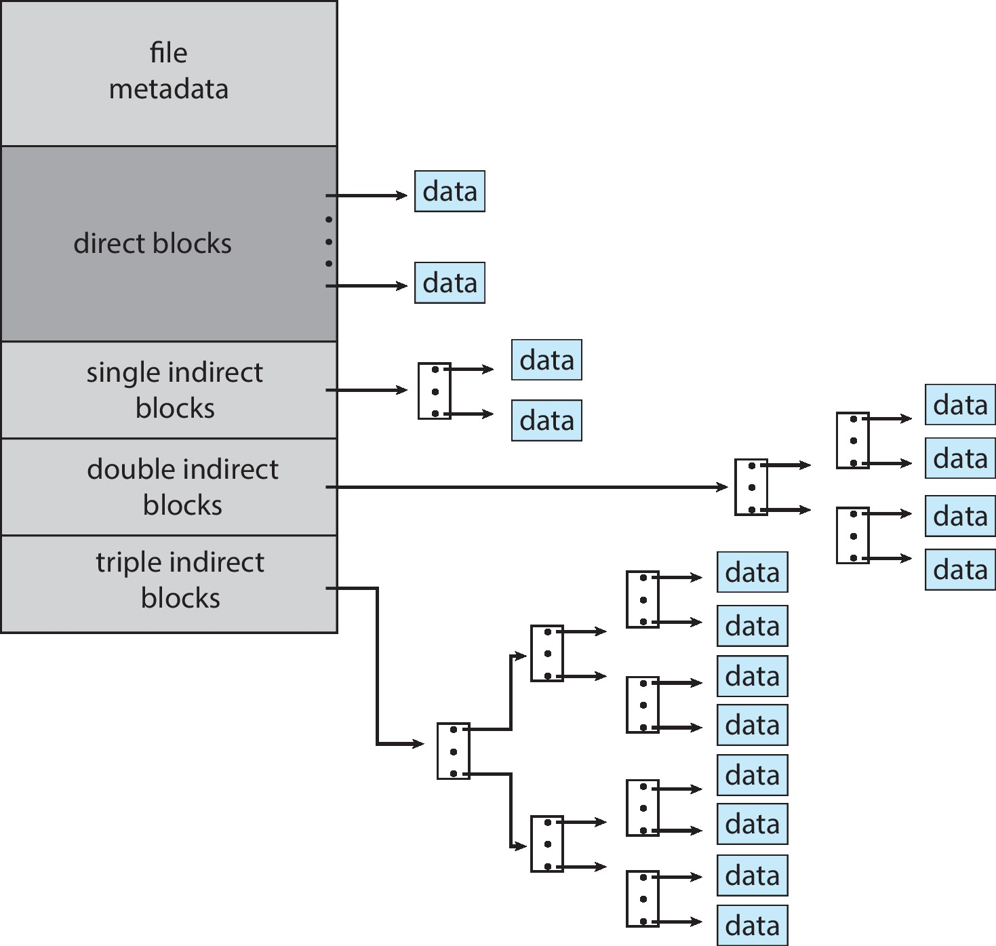
Combined Scheme: UNIX UFS
4K bytes per block, 32-bit addresses
More index blocks than can be addressed with 32-bit file pointer

Slide 31
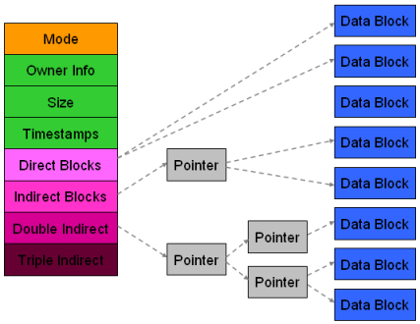
Linux ext4_inode

Slide 32
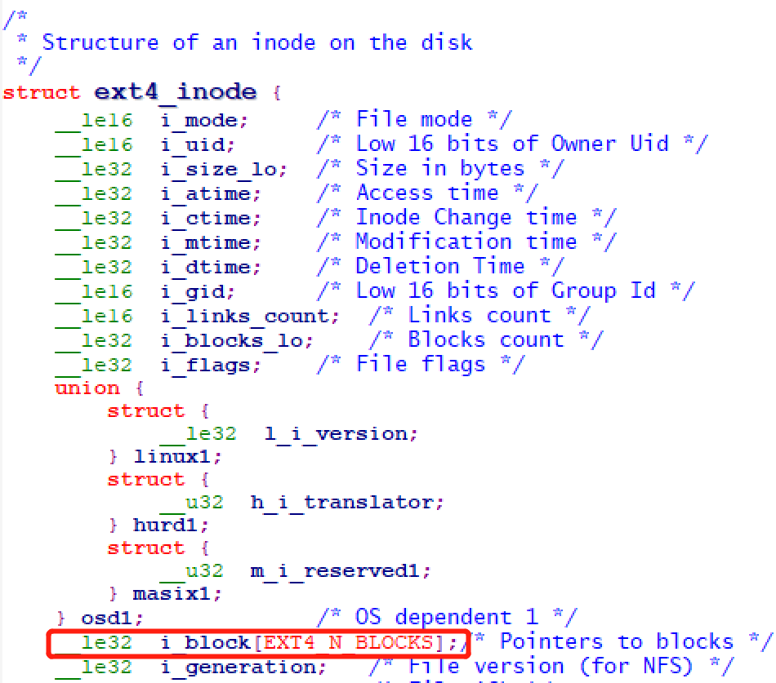
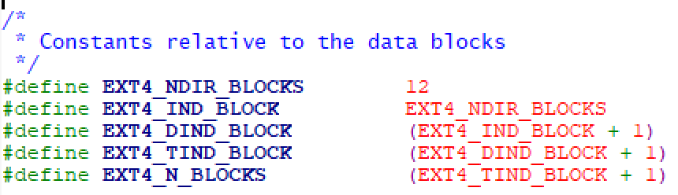
ext4_inode Code
fs/ext4.h

Slide 33
Performance
Best method depends on file access type
  Contiguous great for sequential and random
  Linked good for sequential, not random
Declare access type at creation -> select either contiguous or linked
Indexed more complex
  Single block access could require 2 index block reads then data block read
  Clustering can help improve throughput
For NVM, no disk head so different algorithms and optimizations needed
  Using old algorithm uses many CPU cycles trying to avoid non-existent head movement
  With NVM goal is to reduce CPU cycles and overall path needed for I/O

Slide 34
Free-Space Management
File system maintains free-space list to track available blocks/clusters
  (Using term “block” for simplicity)
Bit vector or bit map (n blocks)
0
1
2
n-1
…
1 ⇒ block[i] free
0 ⇒ block[i] occupied
bit[i] =

Finding the first free block:
(number of bits per word) *
(number of 0-value words) +
offset of first 1 bit
CPUs have instructions to return offset within word of first “1” bit

Slide 35
Free-Space Management (Cont.)
Bit map requires extra space
  Example:
block size = 4KB = 2¹² bytes
disk size = 2⁴⁰ bytes (1 terabyte)
n = 2⁴⁰/2¹² = 2²⁸ bits (or 32MB)
Given that disk size constantly increases, the problem with bit vectors will continue to escalate as well

Slide 36
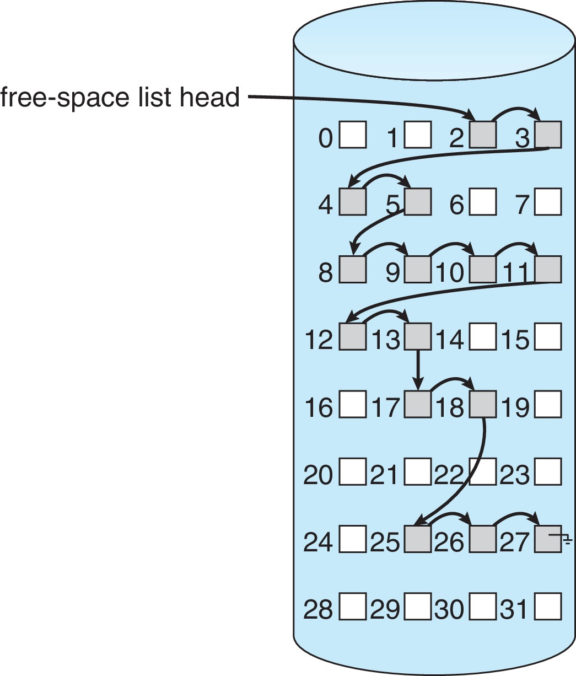
Linked Free Space List on Disk
Linked list (free list)
  Cannot get contiguous space easily
  No waste of space
  No need to traverse the entire list (if # free blocks recorded)

Slide 37
Free-Space Management (Cont.)
Grouping
  Modify linked list to store address of next n-1 free blocks in first free block, plus a pointer to next block that contains free-block-pointers (like this one)
Counting
  Because space is frequently contiguously used and freed, with contiguous allocation, extents, or clustering
    Keep address of first free block and count of following free blocks
    Free space list then has entries containing addresses and counts

Slide 38
Free-Space Management (Cont.)
Space Maps
  In Oracle’s ZFS file system (found in Solaris and some other operating systems)
  Divides device space into metaslab units and manages metaslabs
    Given volume can contain hundreds of metaslabs
  Each metaslab has associated space map
    Uses counting algorithm
  But records to log file rather than file system
    Log of all block activity, in time order, in counting format
  Metaslab activity -> load space map into memory in balanced-tree structure, indexed by offset
    Replay log into that structure
    Combine contiguous free blocks into single entry

Slide 39
Efficiency of Secondary Storage
Disks tend to represent a major bottleneck in system performance
Even NVM devices are slow compared with CPU and main memory
Efficiency dependent on:
  Disk allocation and directory algorithms
  Types of data kept in file’s directory entry
  Pre-allocation or as-needed allocation of metadata structures
  Fixed-size or varying-size data structures

Slide 40
Performance Issues
Performance
  Keeping data and metadata close together
  Buffer cache – separate section of main memory for frequently used blocks
  Synchronous writes sometimes requested by apps or needed by OS
    No buffering / caching – writes must hit disk before acknowledgement
    Asynchronous writes more common, buffer-able, faster
Different algorithms depending on the access type of the file
  Free-behind and read-ahead – techniques to optimize sequential access

Slide 41
Page Cache
A page cache caches pages rather than disk blocks using virtual memory techniques and addresses
Memory-mapped I/O uses a page cache
Routine I/O through the file system uses the buffer (disk) cache
This leads to the following figure

Slide 42
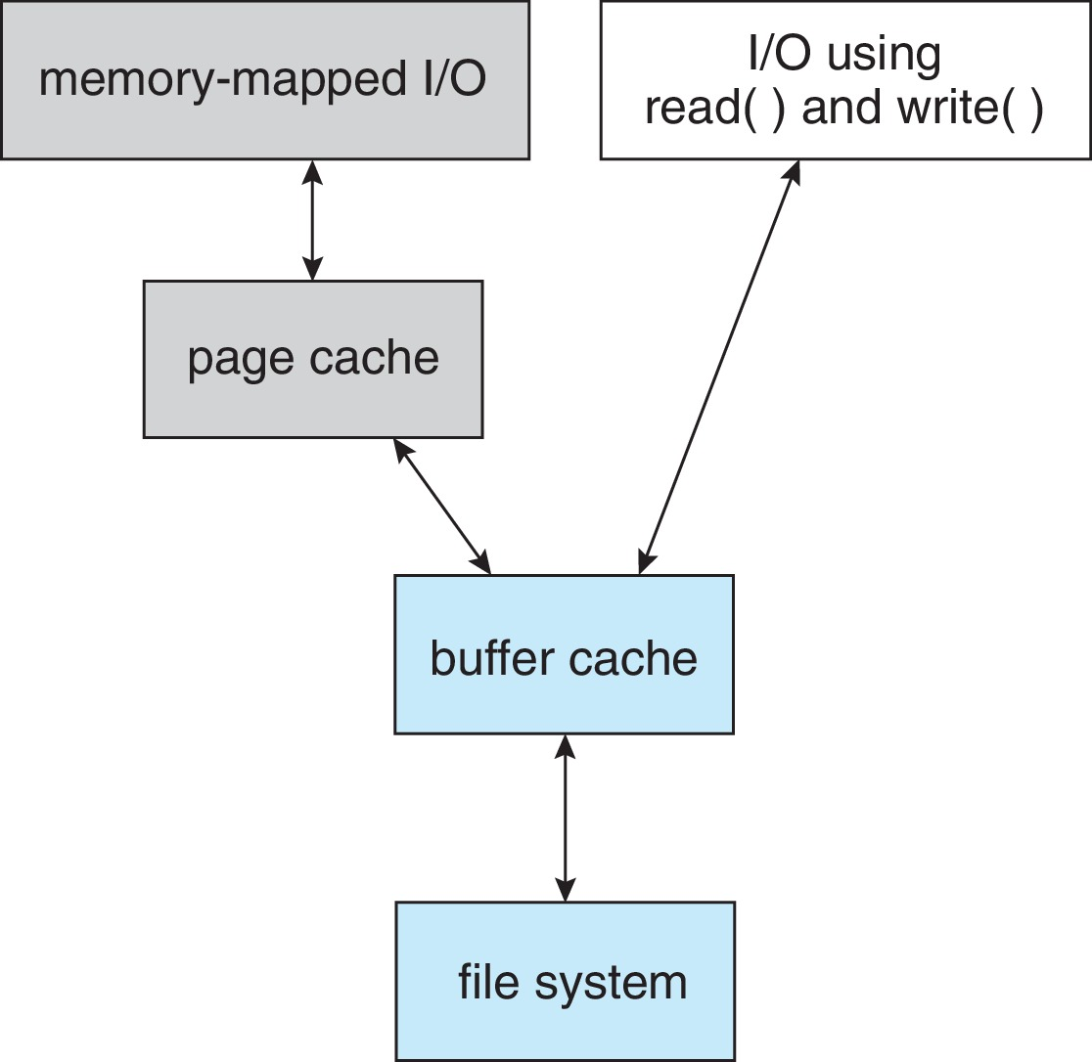
I/O Without a Unified Buffer Cache

Slide 43
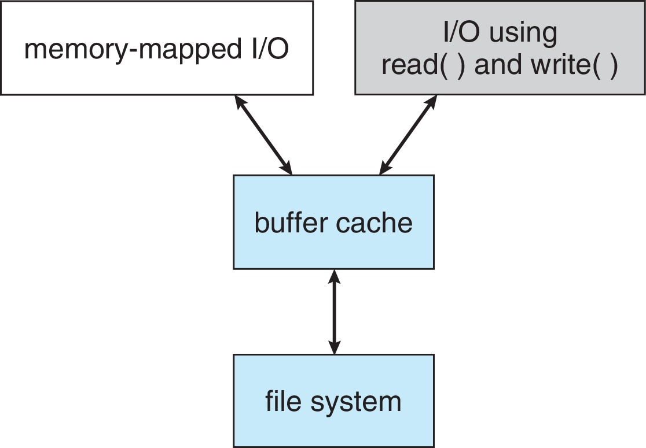
Unified Buffer Cache
A unified buffer cache uses the same page cache to cache both memory-mapped pages and ordinary file system I/O to avoid double caching
  But which caches get priority, and what replacement algorithms to use?

Slide 44
Recovery
A system crash can cause inconsistencies among on-storage file-system data structures
  Eg: Creating a file involves changes to directory structures，inodes, data blocks allocation, and the free counts for all of these blocks, which may be interrupted by crash
Consistency checking – compares data in directory structure with data blocks on disk, and tries to fix inconsistencies
  Can be slow and sometimes fails
Use system programs to back up data from disk to another storage device (magnetic tape, other magnetic disk, optical)
Recover lost file or disk by restoring data from backup

Slide 45
Log Structured File Systems
Log structured (or journaling) file systems record each metadata update to the file system as a transaction
  Now common with ext3, ext4, ZFS, etc.
All transactions are written to a log
  A transaction is considered committed once it is written to the log (sequentially)
  Sometimes to a separate device or section of disk
  However, the file system may not yet be updated
The transactions in the log are asynchronously written to the file system structures
  When the file system structures are modified, the transaction is removed from the log
If the file system crashes, all remaining transactions in the log must still be performed
Faster recovery from crash, removes chance of inconsistency of metadata

